Slide 1
Module 5: CPU Scheduling
Basic Concepts
Scheduling Criteria
Scheduling Algorithms
Multiple-Processor Scheduling
Real-Time Scheduling
Algorithm Evaluation
Operating System Concepts

Slide 2
Basic Concepts
Maximum CPU utilization obtained with multiprogramming
CPU–I/O Burst Cycle – Process execution consists of a cycle of CPU execution and I/O wait.
Operating System Concepts

Slide 3

Alternating Sequence of CPU And I/O Bursts
Operating System Concepts

Slide 4
CPU Scheduler
Selects from among the processes in memory that are ready to execute, and allocates the CPU to one of them.
CPU scheduling decisions may take place when a process:
  1. Switches from running to waiting state.
  2. Switches from running to ready state.
  3. Switches from waiting to ready.
  4. Terminates.
Scheduling under 1 and 4 is nonpreemptive.
All other scheduling is preemptive.
Operating System Concepts

Slide 5
Dispatcher
Dispatcher module gives control of the CPU to the process selected by the short-term scheduler; this involves:
  switching context
  switching to user mode
  jumping to the proper location in the user program to restart that program
Dispatch latency – time it takes for the dispatcher to stop one process and start another running.
Operating System Concepts

Slide 6
Scheduling Criteria
CPU utilization – keep the CPU as busy as possible
Throughput – # of processes that complete their execution per time unit
Turnaround time – amount of time to execute a particular process
Waiting time – amount of time a process has been waiting in the ready queue
Response time – amount of time it takes from when a request was submitted until the first response is produced, not output (for time-sharing environment)
Operating System Concepts

Slide 7
Optimization Criteria
Max CPU utilization
Max throughput
Min turnaround time
Min waiting time
Min response time
Operating System Concepts

Slide 8
First-Come, First-Served (FCFS) Scheduling
Example: Process Burst Time
P₁ 24
P₂ 3
P₃ 3
Suppose that the processes arrive in the order: P₁ , P₂ , P₃
The Gantt Chart for the schedule is:
Waiting time for P₁ = 0; P₂ = 24; P₃ = 27
Average waiting time: (0 + 24 + 27)/3 = 17
P₁
P₂
P₃
0
24
27
30
Operating System Concepts

Slide 9
FCFS Scheduling (Cont.)
Suppose that the processes arrive in the order
P₂ , P₃ , P₁ .
The Gantt chart for the schedule is:
Waiting time for P₁ = 6; P₂ = 0; P₃ = 3
Average waiting time: (6 + 0 + 3)/3 = 3
Much better than previous case.
Convoy effect short process behind long process
P₂
P₃
P₁
0
3
6
30
Operating System Concepts

Slide 10
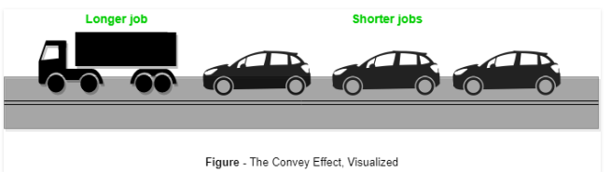
Operating System Concepts

Slide 11
srtf
At p BT
0 p1 7
1 p2 3
2 P3 1
6 P4 1
Operating System Concepts

Slide 12

Operating System Concepts

Slide 13
Shortest-Job-First (SJR) Scheduling
Associate with each process the length of its next CPU burst. Use these lengths to schedule the process with the shortest time.
Two schemes:
  nonpreemptive – once CPU given to the process it cannot be preempted until completes its CPU burst.
  Preemptive – if a new process arrives with CPU burst length less than remaining time of current executing process, preempt. This scheme is know as the
  Shortest-Remaining-Time-First (SRTF).
SJF is optimal – gives minimum average waiting time for a given set of processes.
Operating System Concepts

Slide 14
Operating System Concepts

Slide 15
Example of Non-Preemptive SJF
Process Arrival Time Burst Time
P₁ 0.0 7
P₂ 2.0 4
P₃ 4.0 1
P₄ 5.0 4
SJF (non-preemptive)
Average waiting time = (0 + 6 + 3 + 7)/4 - 4
P₁
P₃
P₂
P₄
0
3
7
8
12
16
Operating System Concepts

Slide 16
Example of Preemptive SJF
Process Arrival Time Burst Time
P₁ 0.0 7
P₂ 2.0 4
P₃ 4.0 1
P₄ 5.0 4
SJF (preemptive)
Average waiting time = (9 + 1 + 0 +2)/4 =3
P₁
P₂
P₃
P₂
P₄
P₁
0
2
4
5
7
11
16
Operating System Concepts

Slide 17
Priority Scheduling
A priority number (integer) is associated with each process
The CPU is allocated to the process with the highest priority (smallest integer ≡ highest priority).
  Preemptive
  nonpreemptive
SJF is a priority scheduling where priority is the predicted next CPU burst time.
Problem ≡ Starvation – low priority processes may never execute.
Solution ≡ Aging – as time progresses increase the priority of the process.
Operating System Concepts
Notes:
Advantages of priority scheduling
Here, are benefits/pros of using priority scheduling method:
Easy to use scheduling method
Processes are executed on the basis of priority so high priority does not need to wait for long which saves time
This method provides a good mechanism where the relative important of each process may be precisely defined.
Suitable for applications with fluctuating time and resource requirements.
Disadvantages of priority scheduling
Here, are cons/drawbacks of priority scheduling
If the system eventually crashes, all low priority processes get lost.
If high priority processes take lots of CPU time, then the lower priority processes may starve and will be postponed for an indefinite time.
This scheduling algorithm may leave some low priority processes waiting indefinitely.
A process will be blocked when it is ready to run but has to wait for the CPU because some other process is running currently.
If a new higher priority process keeps on coming in the ready queue, then the process which is in the waiting state may need to wait for a long duration of time.

Slide 18
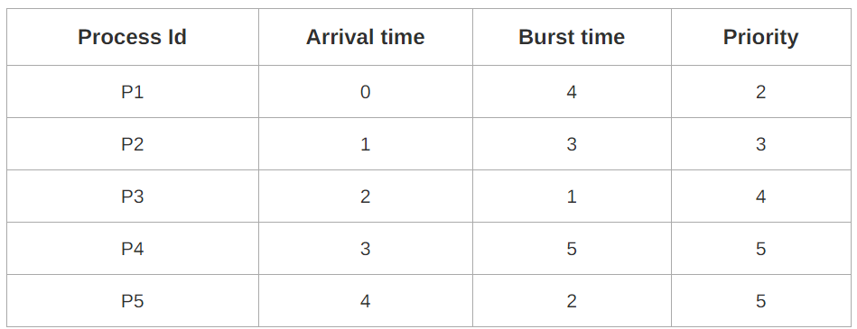
Operating System Concepts

Slide 19
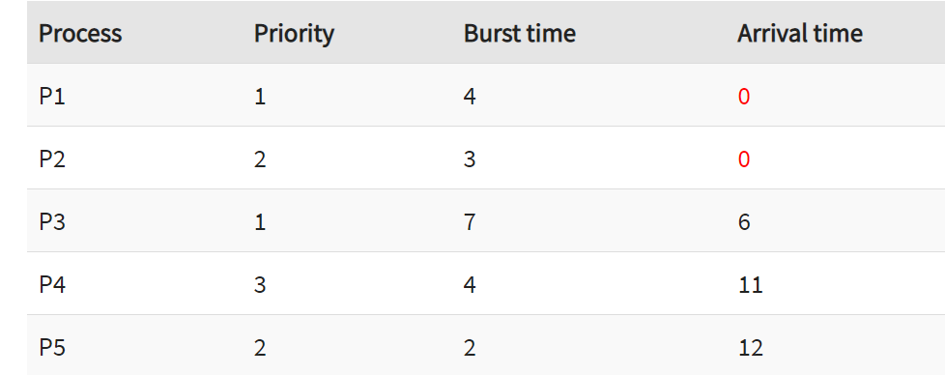
Operating System Concepts
Notes:
P1 = o - o = o P2 =4 - o + 7 =11 P3= 6-6=0 P4= 16-11=5 Average Waiting time = (0+11+0+5+2)/5 = 18/5= 3.6

Slide 20
Round Robin (RR)
Each process gets a small unit of CPU time (time quantum), usually 10-100 milliseconds. After this time has elapsed, the process is preempted and added to the end of the ready queue.
If there are n processes in the ready queue and the time quantum is q, then each process gets 1/n of the CPU time in chunks of at most q time units at once. No process waits more than (n-1)q time units.
Performance
  q large ⇒ FIFO
  q small ⇒ q must be large with respect to context switch, otherwise overhead is too high.
Operating System Concepts

Slide 21
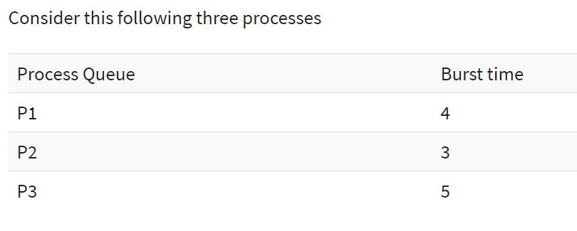
Time Quantum is 2
Operating System Concepts

Slide 22
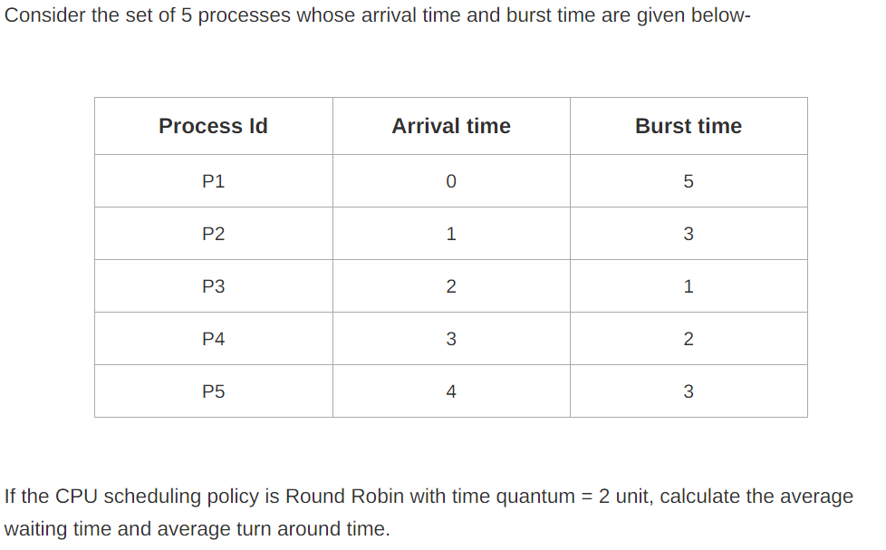
Operating System Concepts

Slide 23
Example: RR with Time Quantum = 20
Process Burst Time
P₁ 53
P₂ 17
P₃ 68
P₄ 24
The Gantt chart is:
Typically, higher average turnaround than SJF, but better response.
P₁
P₂
P₃
P₄
P₁
P₃
P₄
P₁
P₃
P₃
0
20
37
57
77
97
117
121
134
154
162
Operating System Concepts

Slide 24
Operating System Concepts

Slide 25
Q. Consider the following processes with arrival time and burst time. Calculate average turnaround time, average waiting time and average response time using round robin with time quantum 3?
Process id | Arrival time | Burst time
P1 | 5 | 5
P2 | 4 | 6
P3 | 3 | 7
P4 | 1 | 9
P5 | 2 | 2
P6 | 6 | 3
Operating System Concepts

Slide 26
TQ=3
PROCESS | ARRIVAL TIME | BURST TIME
P1 | 0 | 10
P2 | 1 | 4
P3 | 2 | 5
P4 | 3 | 3
Operating System Concepts

Slide 27

How a Smaller Time Quantum Increases Context Switches
Operating System Concepts

Slide 28

Turnaround Time Varies With The Time Quantum
Operating System Concepts

Slide 29
Multilevel Queue
Ready queue is partitioned into separate queues:
foreground (interactive)
background (batch)
Each queue has its own scheduling algorithm,
foreground – RR
background – FCFS
Scheduling must be done between the queues.
  Fixed priority scheduling; i.e., serve all from foreground then from background. Possibility of starvation.
  Time slice – each queue gets a certain amount of CPU time which it can schedule amongst its processes; i.e.,
  80% to foreground in RR
  20% to background in FCFS
Operating System Concepts

Slide 30

Multilevel Queue Scheduling
Operating System Concepts

Slide 31
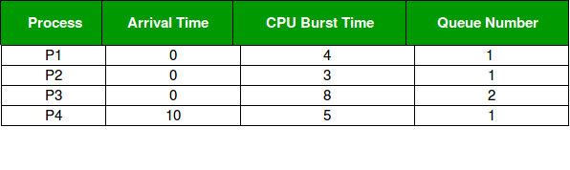
Consider below table of four processes under Multilevel queue scheduling.Queue number denotes the queue of the process.
Priority of queue 1 is greater than queue 2. queue 1 uses Round Robin (Time Quantum = 2) and queue 2 uses FCFS.
Operating System Concepts

Slide 32
Multilevel Feedback Queue
A process can move between the various queues; aging can be implemented this way.
Multilevel-feedback-queue scheduler defined by the following parameters:
  number of queues
  scheduling algorithms for each queue
  method used to determine when to upgrade a process
  method used to determine when to demote a process
  method used to determine which queue a process will enter when that process needs service
Operating System Concepts

Slide 33

Multilevel Feedback Queues
Operating System Concepts

Slide 34
Example of Multilevel Feedback Queue
Three queues:
  Q₀ – time quantum 8 milliseconds
  Q₁ – time quantum 16 milliseconds
  Q₂ – FCFS
Scheduling
  A new job enters queue Q₀ which is served FCFS. When it gains CPU, job receives 8 milliseconds. If it does not finish in 8 milliseconds, job is moved to queue Q₁.
  At Q₁ job is again served FCFS and receives 16 additional milliseconds. If it still does not complete, it is preempted and moved to queue Q₂.
Operating System Concepts

Slide 35
Gate Question
Consider a system which has a CPU bound process,which require the burst time of 40 seconds.The multilevel Feed Back Queue scheduling algorithm is used and the queue time quantum '2' seconds and in each level it is incremented by '5' seconds.Then how many times the process will be interrupted and on which queue the process will terminate the execution?
(a) 5,4 (b) 4,5 (c) 3,4 (d) 4,3
Operating System Concepts

Slide 36
Solution
Process P needs 40 Seconds for total execution.
Multilevel Feedback queue:
Queue1 = 2
Queue2 = 7 (2+5)
Queue3 = 12 (7+5)
Queue4 = 17 (12+5)
Queue5 = 2 (left time)
hence you can see process is interrupted 4 times, and on 5th qeueue
process completed its execution.
Hence, (b) is correct option
Operating System Concepts

Slide 37
Multiple-Processor Scheduling
CPU scheduling more complex when multiple CPUs are available.
Homogeneous processors within a multiprocessor.
Load sharing
Asymmetric multiprocessing – only one processor accesses the system data structures, alleviating the need for data sharing.
Operating System Concepts

Slide 38
Asymmetric multiprocessing
Symmetric multiprocessing
In Symmetric multiprocessing, we have:
Issues
Processor Affinity- A process has an affinity for the processor on which it is currently running
Hard affinity- allowing a process not to migrate between processors
Soft affinity-When an OS has policy of attempting to keep a process running on the same processor but not guarenteeing
Operating System Concepts

Slide 39
MULTICORE PROCESSORS
Multiple processor cores on the same physical chip
Operating System Concepts

Slide 40
Load Balancing
Attempts to keep workload evenly distributed across the processors in a SMP
Two General Approaches
-Pull Migration – AN idle processor pulls a waiting task from a busy processor
-Push Migration – A specific task periodically checks the load on each processor and if it finds an imbalance-evenly distributes the load by moving processes from overloaded to idle or less busy processor.
Operating System Concepts

Slide 41
Real-Time Scheduling
Hard real-time systems – required to complete a critical task within a guaranteed amount of time.
Soft real-time computing – requires that critical processes receive priority over less fortunate ones.
Operating System Concepts

Slide 42
Rate Monotonic Scheduling
In rate-monotonic scheduling algorithm a static priority policy with preemption is used. Whenever a high priority process arrives it will preempt a lower priority process. Every process gets the priority according to its period. Lower the period higher is the priority. Also, the processing time remains the same in each period.
Operating System Concepts

